Slide 1
Functionalities of Operating System
By
M. BABY ANUSHA,
ASST.PROF IN CSE DEPT.,
RGUKT,NUZVID

Slide 2
Introduction :
It boots the computer.
It performs basic computer tasks e.g. managing the various peripheral devices e.g. mouse, keyboard.
It provides a user interface, e.g. command line, graphical user interface (GUI)

Slide 3
Introduction :
It handles system resources such as the computer's memory and sharing of the central processing unit(CPU) time by various applications or peripheral devices.
It provides file management which refers to the way that the operating system manipulates, stores, retrieves, and saves data.
Error Handling is done by the operating system. It takes preventive measures whenever required to avoid errors.

Slide 4
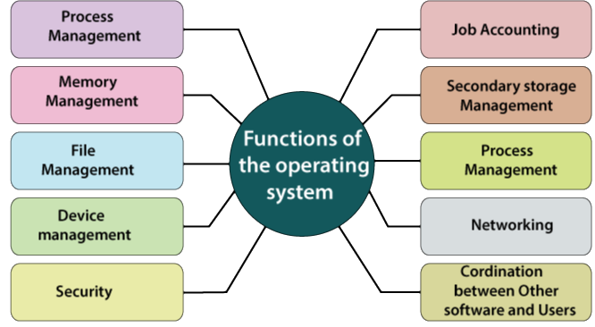

Slide 5
Operating System Management Tasks
Process management which involves putting the tasks into order and pairing them into manageable size before they go to the CPU.
Memory management which coordinates data to and from RAM (random-access memory) and determines the necessity for virtual memory.
Device management provides an interface between connected devices.

Slide 6
Operating System Management Tasks
Storage management which directs permanent data storage.
An application that allows standard communication between software and your computer.
The user interface allows you to communicate with your computer.

Slide 7
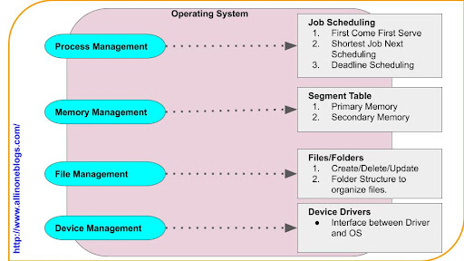

Slide 8
Process Management:
Process Management: – Process Management support operating system to create and delete processes.
Process management also offers a mechanism for synchronization and communication among processes.

Slide 9
Process Management:
An operating system performs the following activities for process management:
The operating system maintains the track of the processor and the status of a process. The software which performs this task is referred to as a traffic controller.
It assigns the processor to the process.
It also performs the task of the de-allocated processor, if a process is no longer needed for the processor.

Slide 10
Memory Management:
Memory Management: – Memory Management is used to manage Primary memory as well as secondary memory.
The memory management module performs the allocation job and de-allocation of memory to the program.

Slide 11
The operating system performs various activities for memory management are:
It keeps track of memory means which part of the memory is in use, and what part of the memory is not in use.
Operating system helps to allocate the memory at the time when the process request for memory.
If process no longer needs memory, then de-allocates the memory.
In multiprogramming, the task of memory allocation to the processes is done with the help of Operating System.

Slide 12
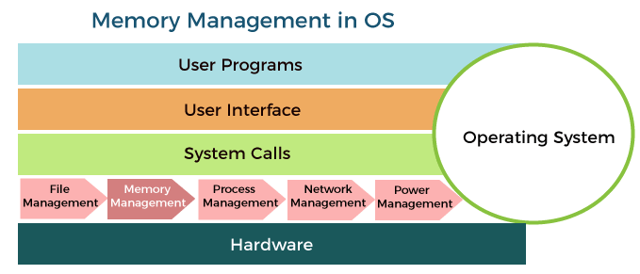

Slide 13
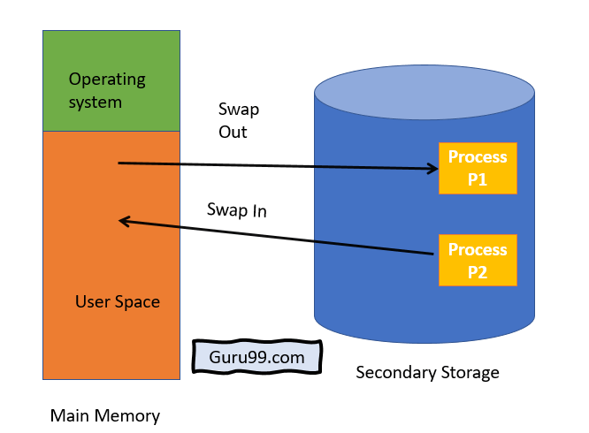

Slide 14
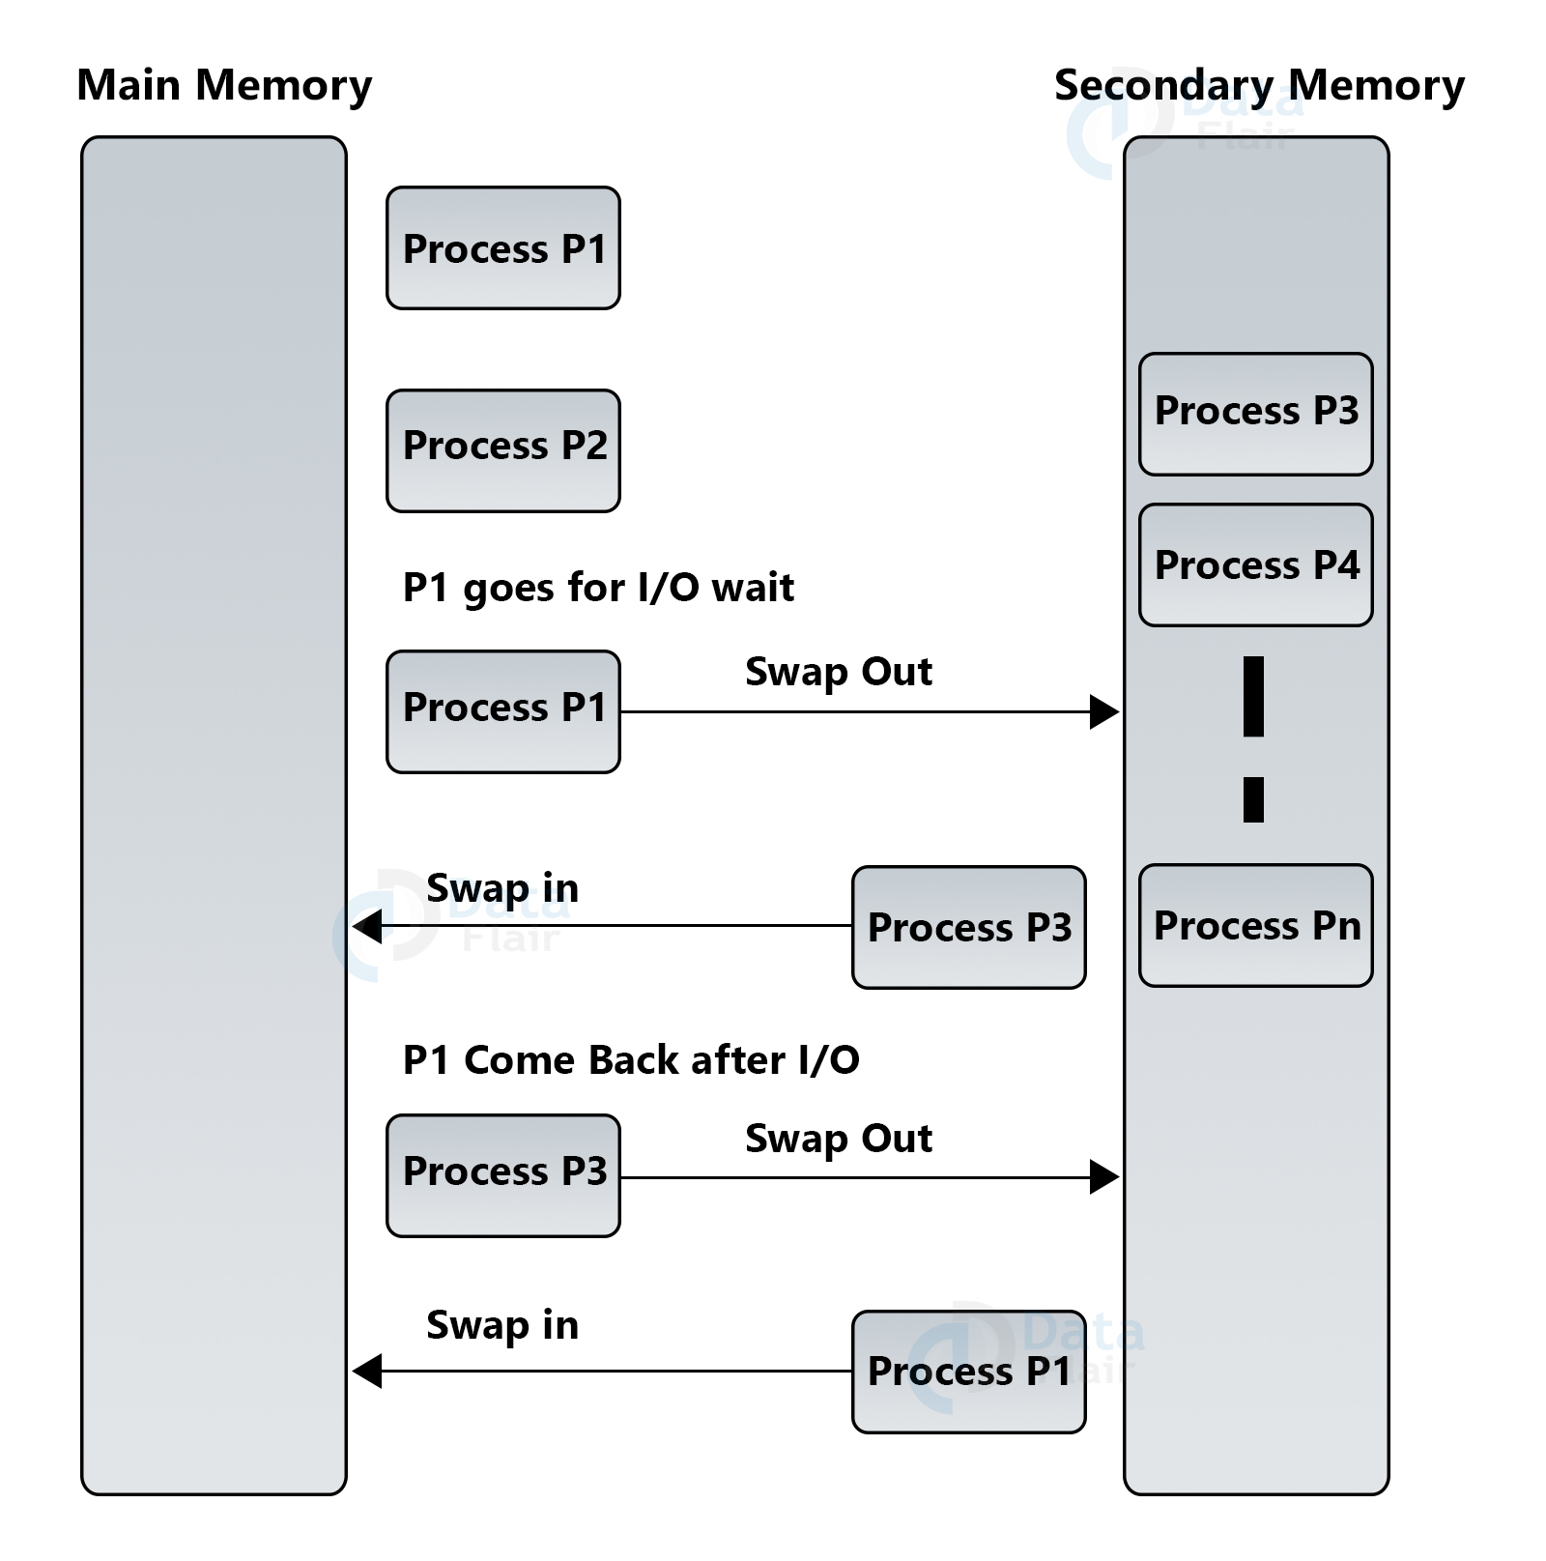

Slide 15
File Management:
File Management: – For fast or simple navigation and easy usage file system is organized into directories. These directories consist of sub-directories and other files.
It helps to handle all the file-related tasks like organization storage, retrieval, sharing, naming and files protection. It preserves track of information, location, status, user, etc.

Slide 16
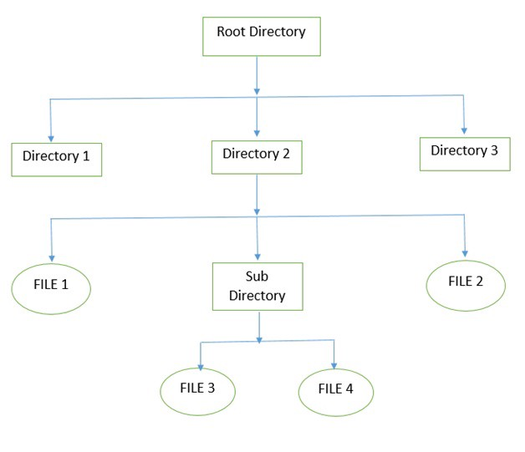

Slide 17
Device Management:
Device Management: – Operating System performs the task of allocations and de-allocations of the devices. It helps to keeps the track of all the devices.
With the help of Operating system, device communication via their respective drivers is performed. It manages the device in an effective manner.

Slide 18
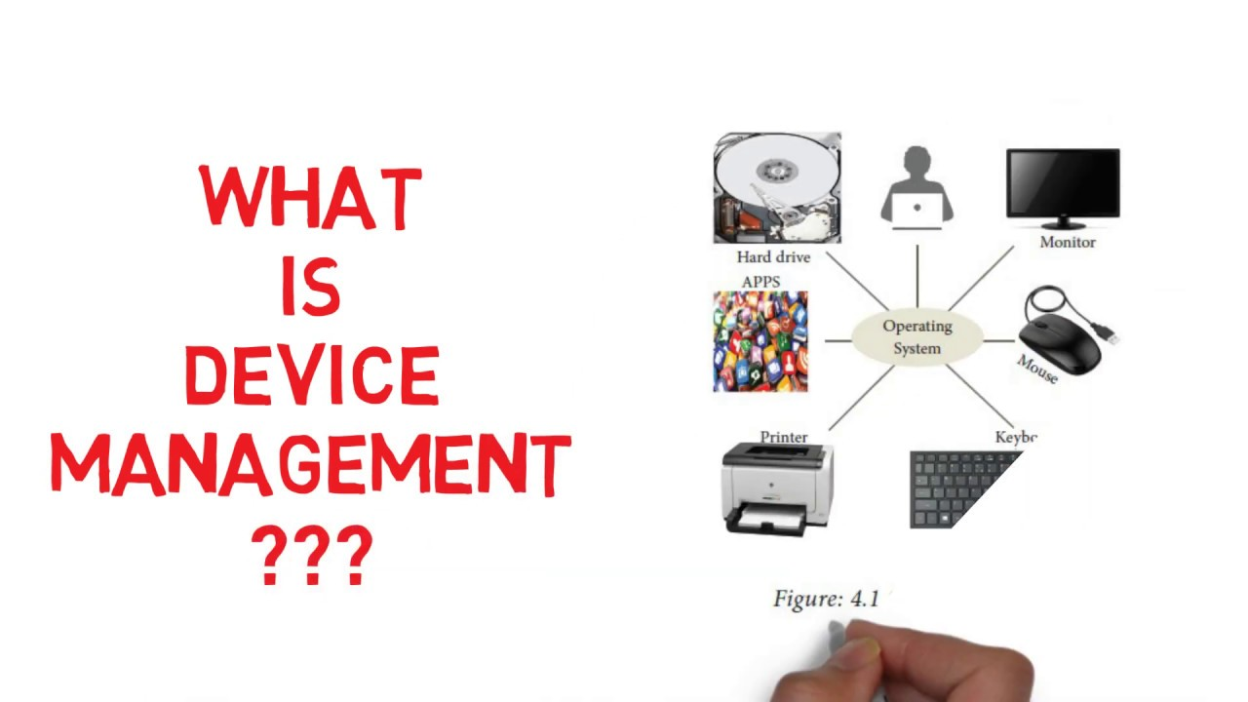

Slide 19
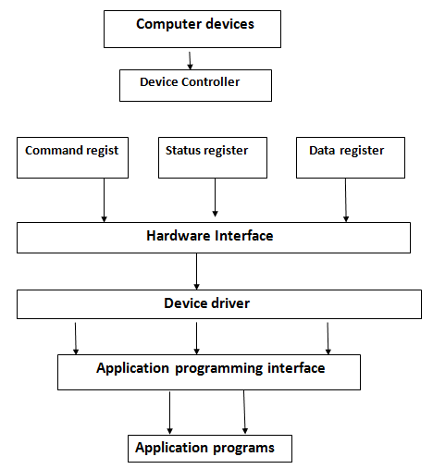

Slide 20
Secondary Storage Management:
Secondary Storage Management: – Operating System is responsible for secondary storage management.
The System has various levels of storage that consist of primary storage, secondary storage, and cache storage.
The set of instruction and data are stored in primary memory or cache memory so that the program which is running can reference it.

Slide 21
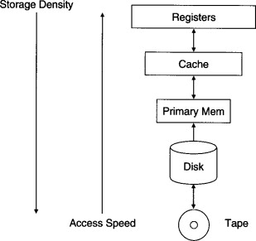

Slide 22
Security:
Security: – The Operating system is responsible for security means the operating system prevents the data and information from unauthorized access and threats.
The operating system uses password protection to protect user data and similar other techniques. It also prevents unauthorized access to programs and user data.

Slide 23


Slide 24
Coordination between other software and user:
Coordination between other software and user: – The operating system also performs the task of coordination between other software and users.
OS directs as well as allocates assemblers, interpreters, compilers, and other software to different computer system users.

Slide 25
Coordination between other software and user:
Control over system performance – Monitors overall system health to help improve performance.
Records the response time between service requests and system response to having a complete view of the system health.
This can help improve performance by providing important information needed to troubleshoot problems.

Slide 26
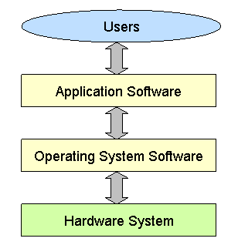

Slide 27
Networking:
Networking: – A distributed system means a bunch of processors which do not share memory hardware devices and clock.
With the help of the network, the processor communicates with each other.

Slide 28
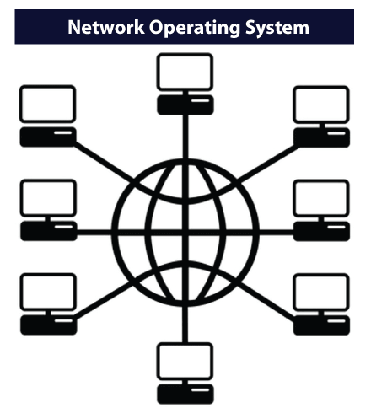

Slide 29
Job accounting:
Job accounting: – Operating system performs the function of job accounting by keeping the track of time and resource used by several jobs and users.

Slide 30
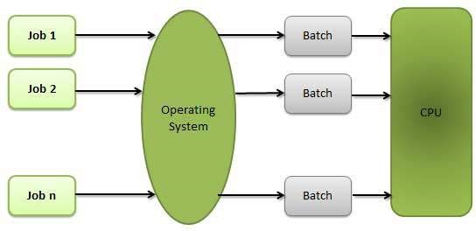

Slide 31
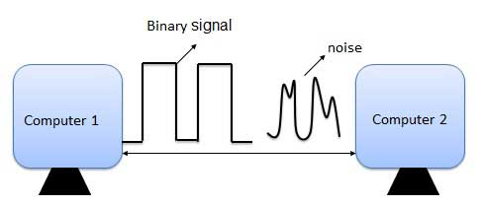
Error detecting aids:
Error detecting aids: – The operating system also performs the task of error detection. It continuously monitors the system to find or detect errors and prevents the system from the error.

Slide 32


